Slide 1

Tobacco’s Impact on Reproductive Health

Slide 2


Tobacco use is an important health risk for Jenu Kuruba women.
Notes:
Think of a different way to introduce the topic.

Slide 3

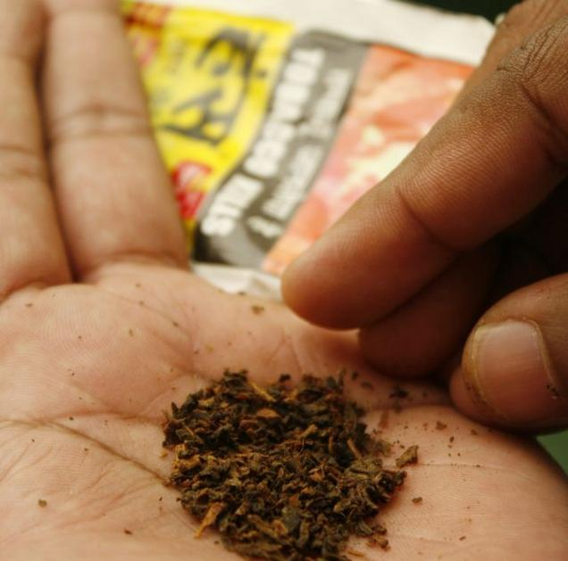
People usually use tobacco…
For pleasure
To satisfy nicotine addiction
For social purposes
For rituals

Slide 4
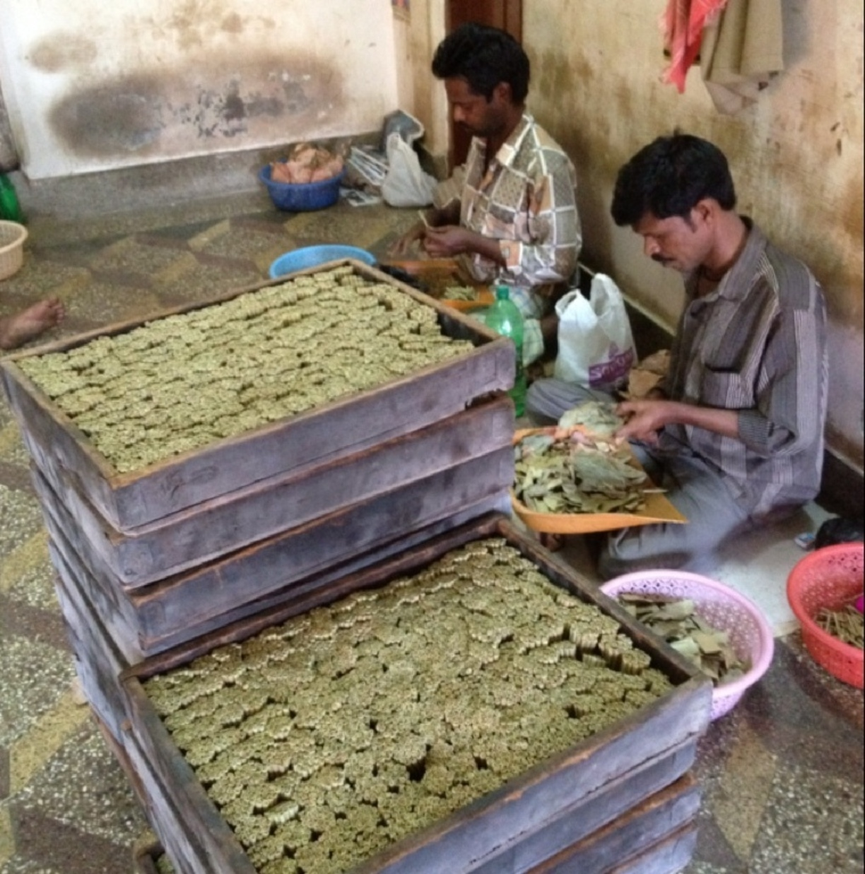
Even though smokeless tobacco might be an important part of culture and your economic livelihood, it can lead to many negative health outcomes.

Slide 5
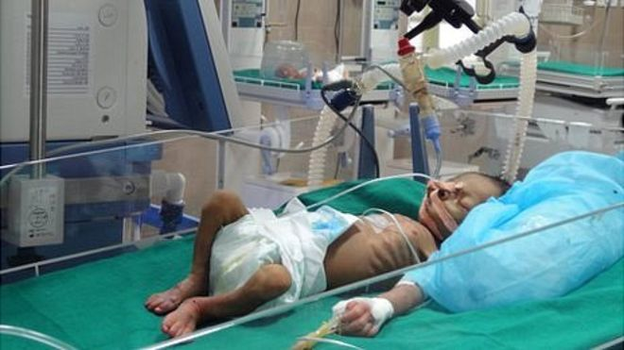
For example, smokeless tobacco can lead to higher rates of preterm birth and low birth weight.

Slide 6
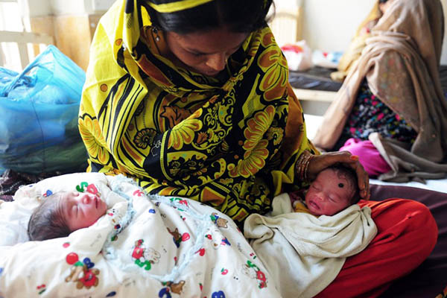
Using smokeless tobacco can cause other problems, such as increased rate of stillbirths.

Slide 7
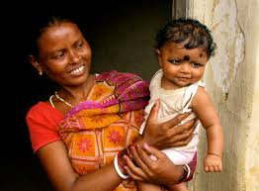
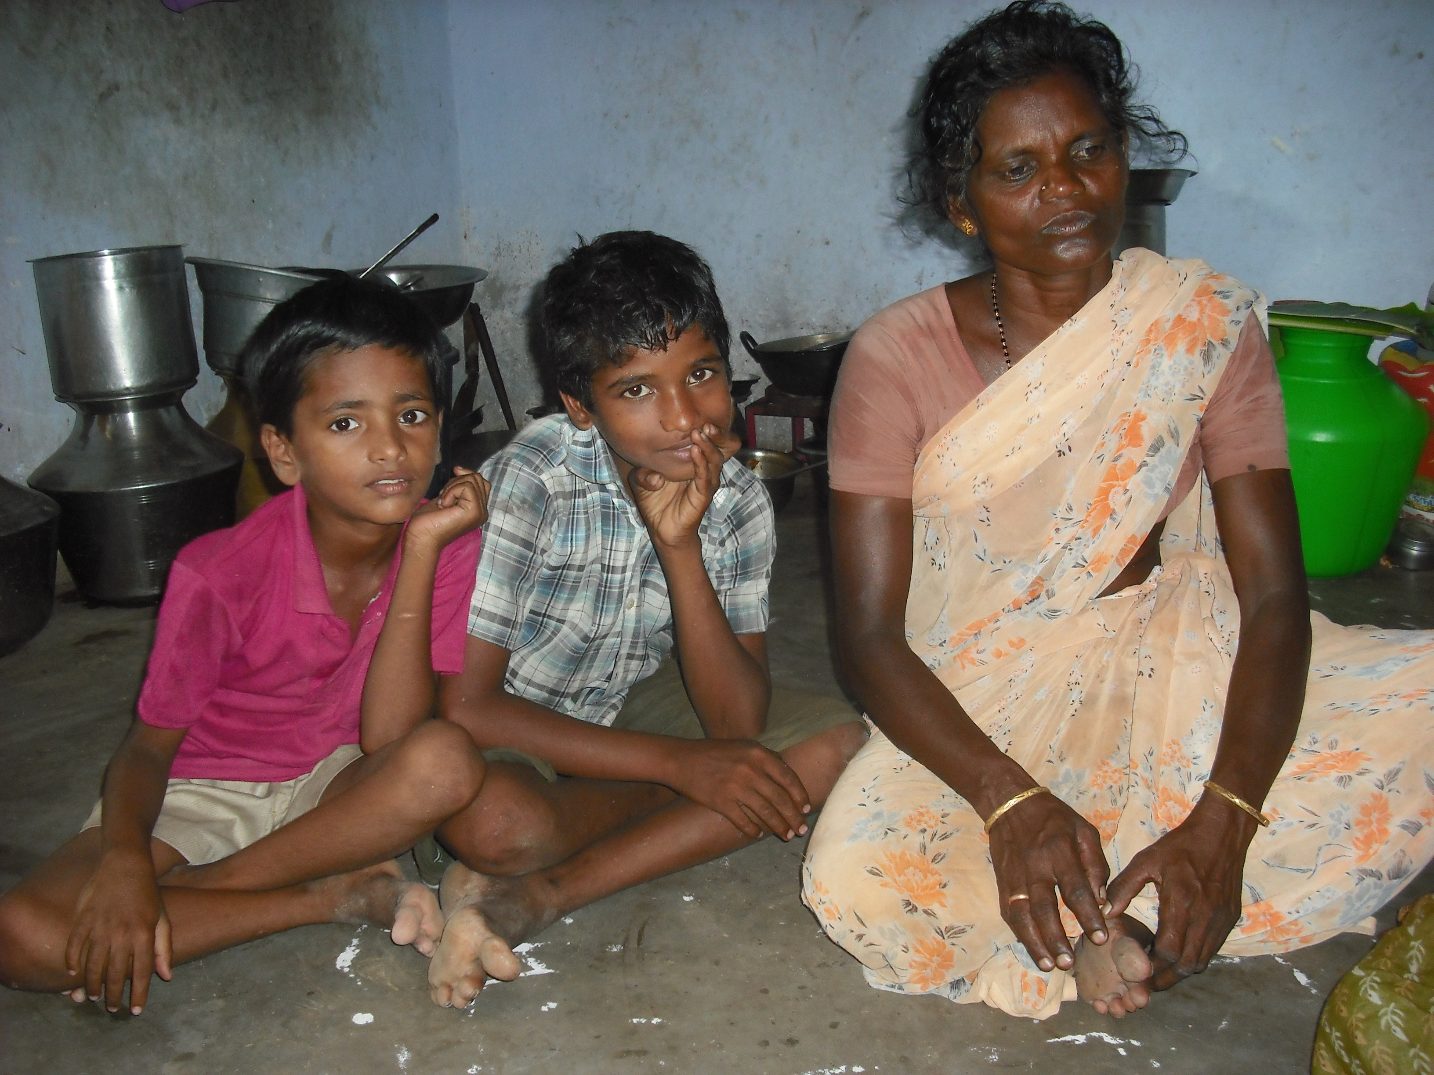
Smokeless tobacco can cause lower fertility and early menopause.

Slide 8
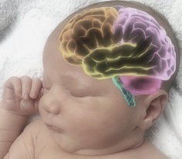
Smokeless tobacco can alter brain development in your infant before it is born.

Slide 9
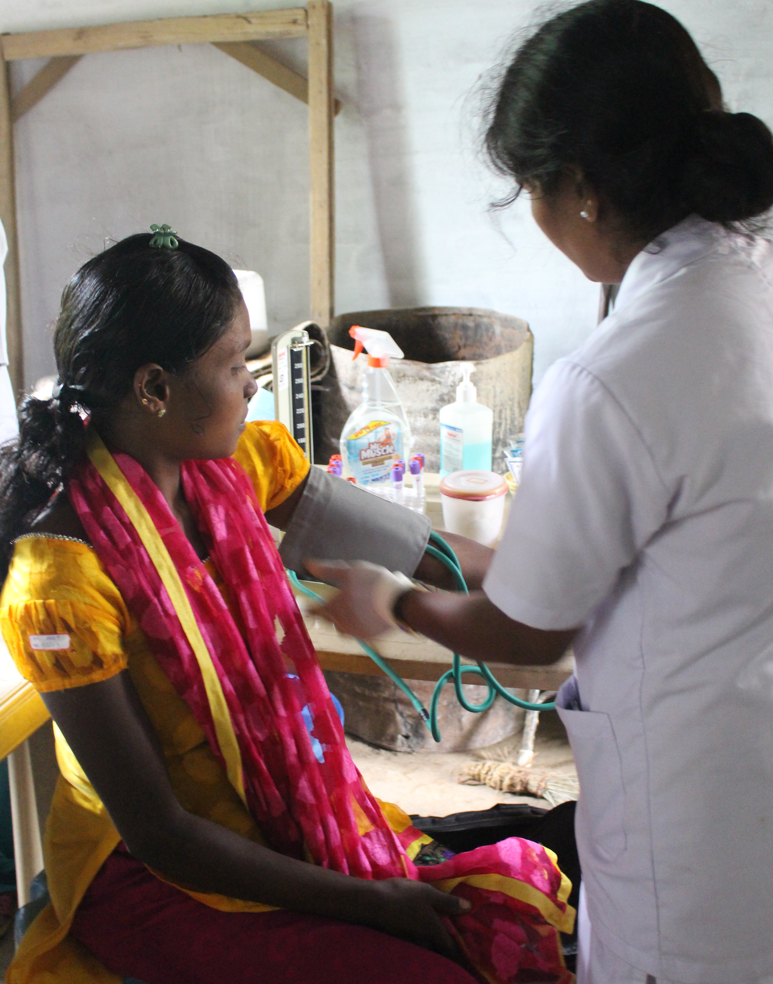
Smokeless tobacco can increase your blood pressure, which can negatively impact your pregnancy.
Notes:
Find a picture of a pregnant woman
Breast feeding and tobacco use

Slide 10
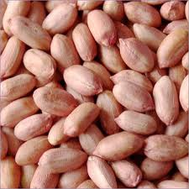
There are many ways to stop using smokeless tobacco. The first way is to replace tobacco with seeds or nuts.

Slide 11
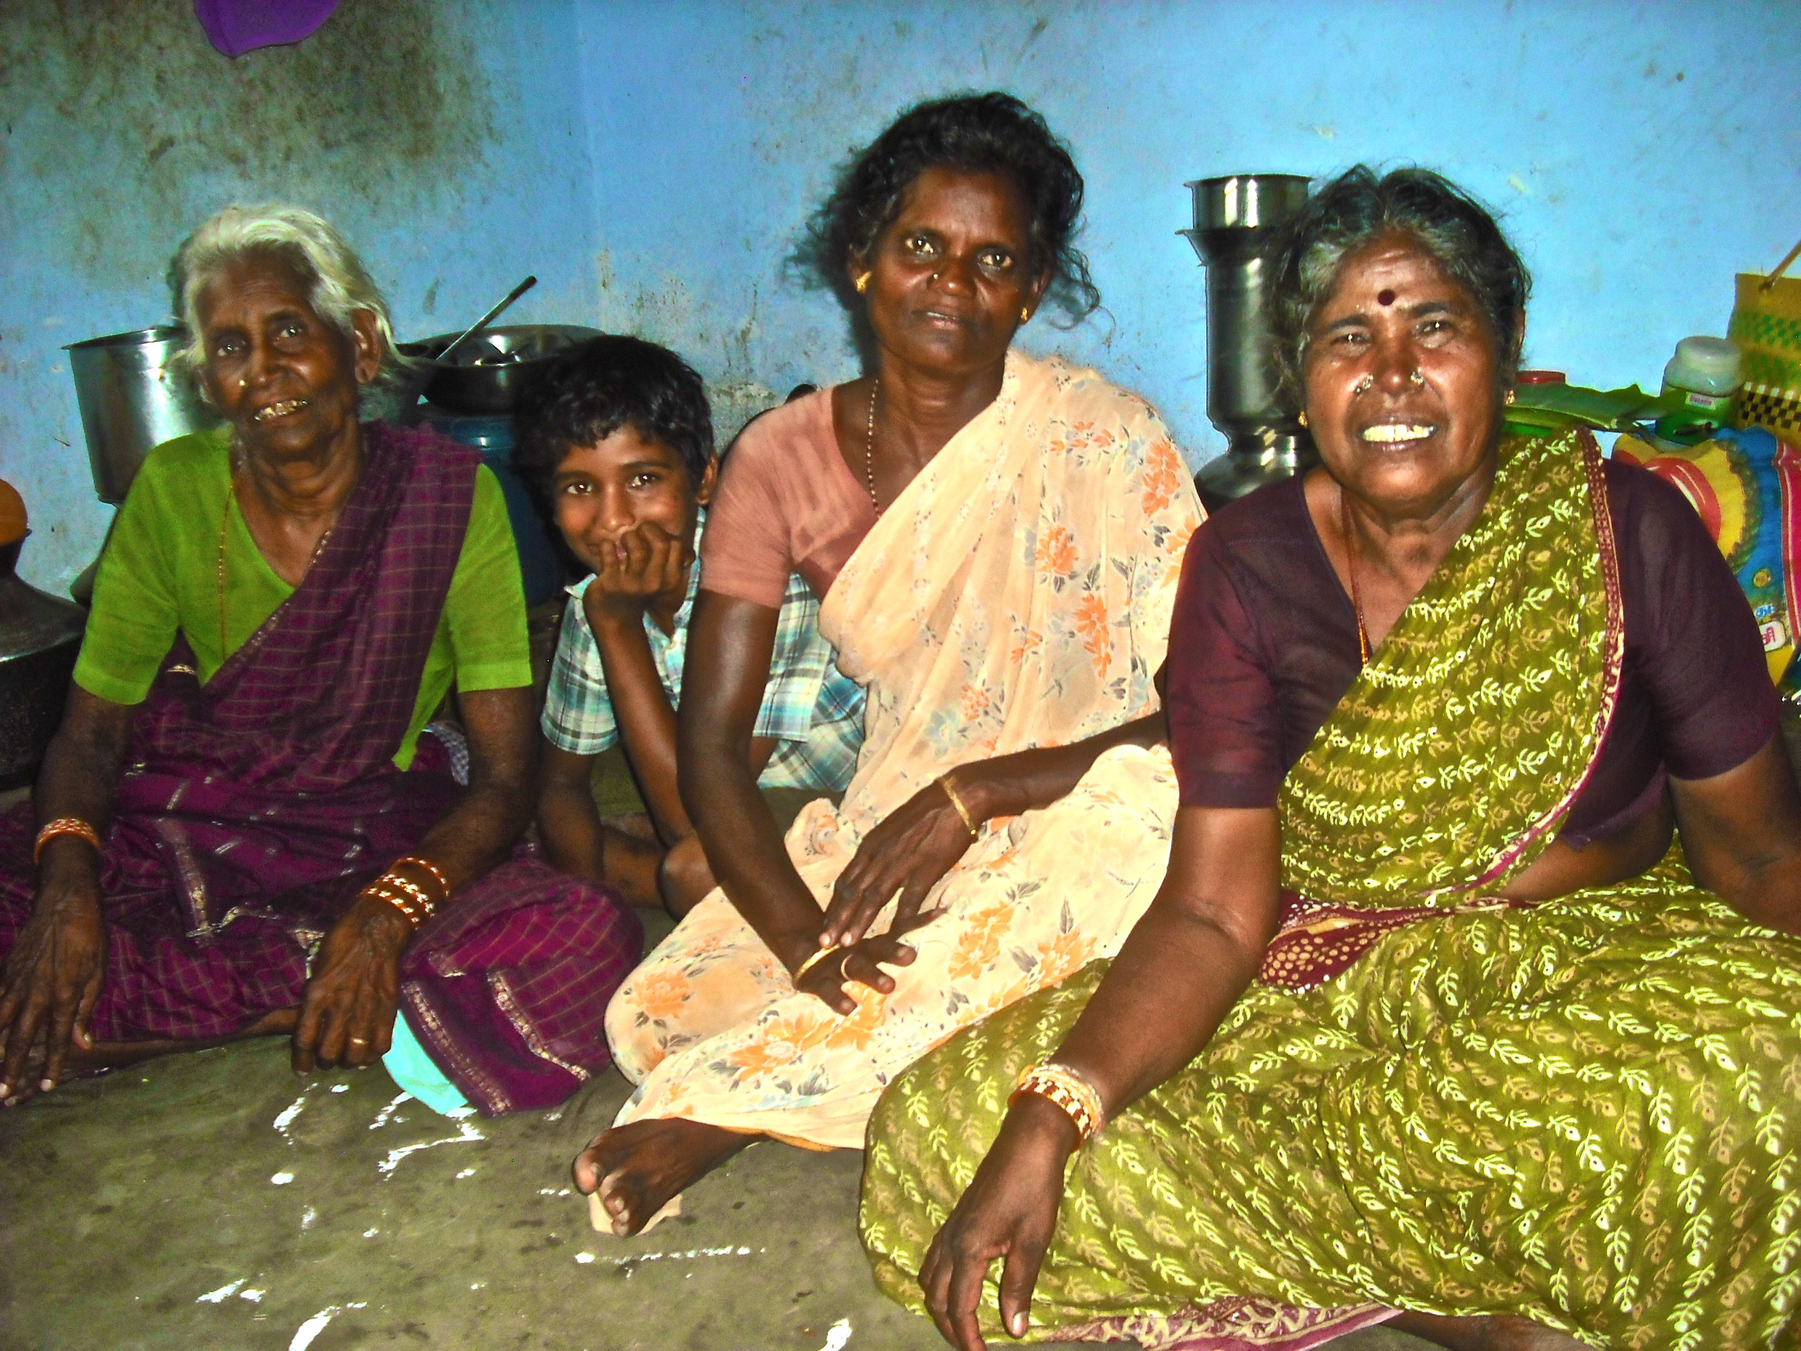
Rely on your friends and family for support. If they also use tobacco, then educate them on the health risks.

Slide 12
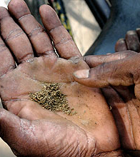
If quitting is too difficult, first try to cut your tobacco use by half.
Notes:
Ask people to evaluate messages and to report what they think about the messages.
Add quiz questions at the end (list effects of tobacco use)

Slide 13
Quiz Question
What are 5 ways that smokeless tobacco can impact your reproductive health?
Source:
http://www.cdc.gov/tobacco/data_statistics/fact_sheets/smokeless/health_effects/

